Slide 1


Projet PTS : Traffic Simulator
Team 103
Johann de Soyres
Anas Hadhri
Junhui Li

Slide 2


Problematic & Context
- Waste of time
- Pollution
- Accidents

Slide 3
How can we simulate traffic flows in big cities ?

Slide 4
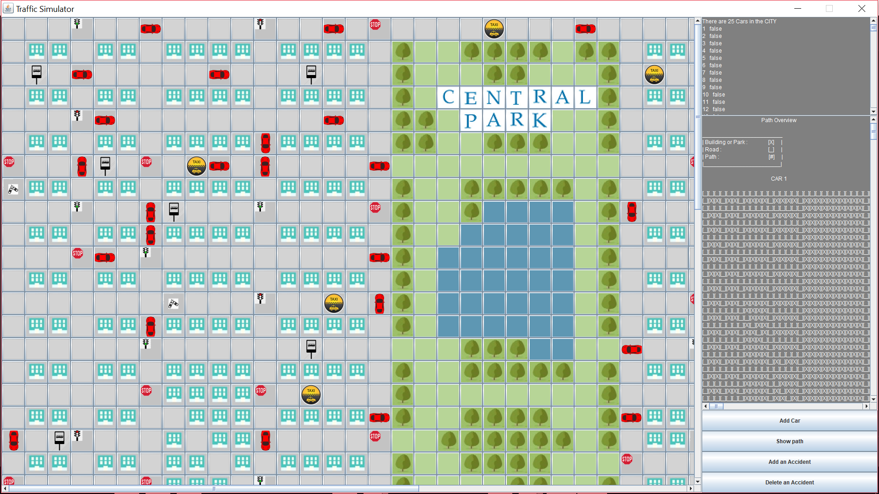
Traffic Simulation Application
Java Application (Java 8, Java SWING)

Slide 5
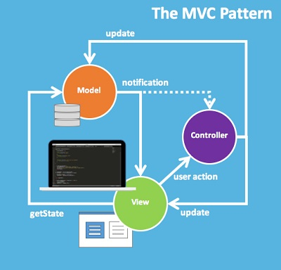


Workflow

Slide 6
Pathfinding algorithm

Slide 7
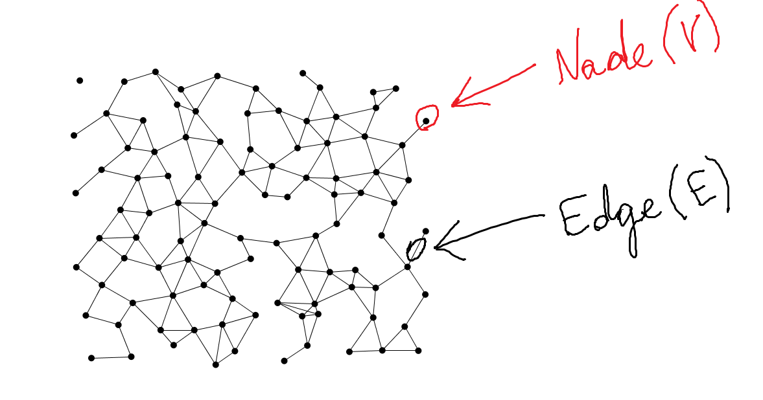
Graph data structure

Slide 8
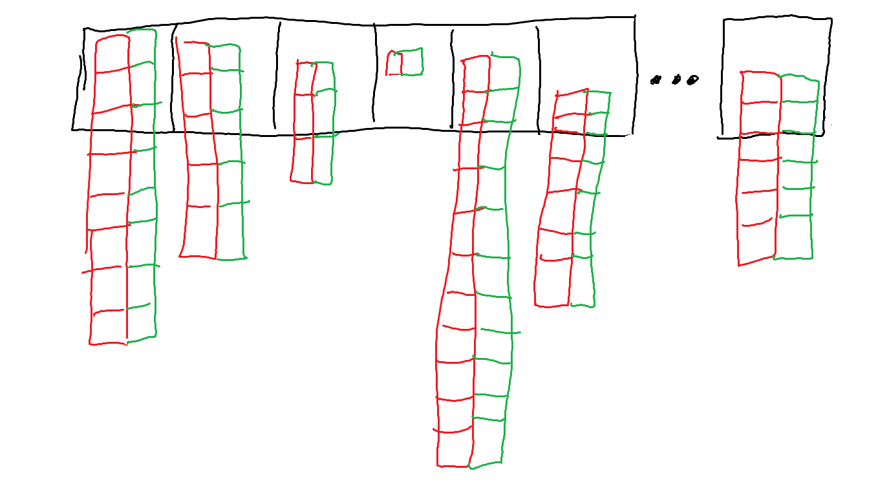
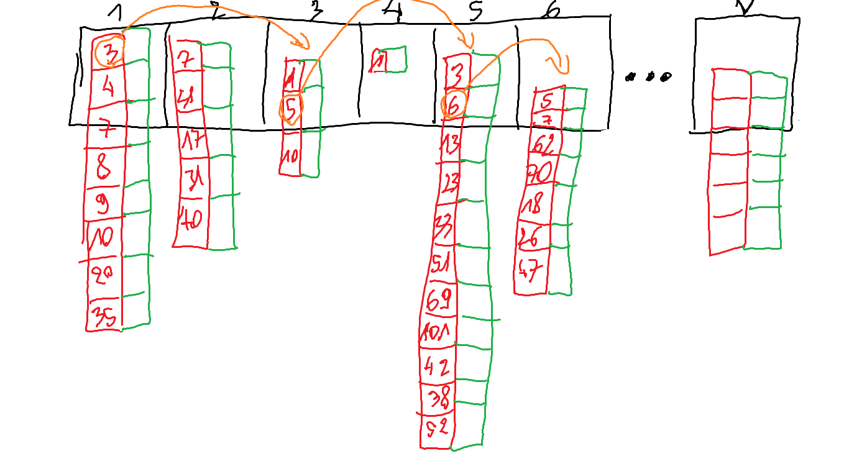
Graph data structure
■ List of nodes
■ Array of neighbors
■ Array of costs
cost : distance and time to go to the next node

Slide 9
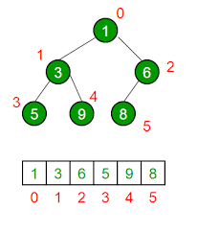
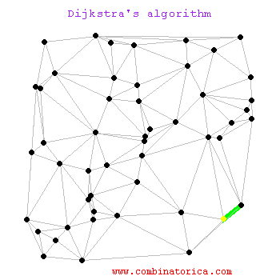
Dijkstra algorithm
Array
Dijkstra Time complexity : O(V*V)
Indexed Minimum priority Queue
Dijkstra Time complexity : O(E*log(V))

Slide 10
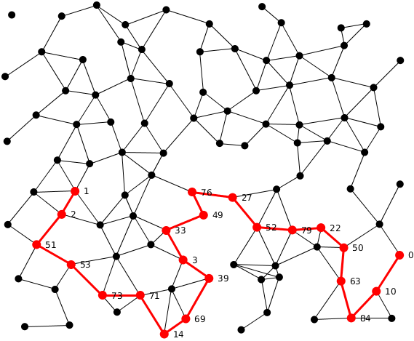
Astar algorithm
Astar Time complexity : O(E)

Slide 11



Difficulties
How can we define the model ?
City → Graph
Display and overlay pictures with Java SWING
Resolve Git conflicts

Slide 12


Potential customers
Town halls
Private companies in highway construction

Slide 13
Improvements
Undirected Roads → Directed Roads
Adding an ambulance to handle accidents
Simulate traffic on smart cities

Slide 14
Questions ?

